Slide 1

DEMONSTRATION OF SLOT CAM AND FOUR SLIDER MECHANISM
3D Printing Process – Project
By
SOWMIYA N (212221230106) – II year AI-DS
KESHIKA S V (212221050028) – II year EEE
Guide : Dr. Vignesh Sekar. M.E., Ph.D – Assistant Professor
Department of Mechanical Engineering

Slide 2
ABSTRACT
A mechanism is easy to understand when it is been visualized practically.
This project aims at demonstrating the mechanism of the Slot Cam and Four slider followers enabling one to understand the mechanism or concept behind it with a practical approach.
The measurements were created using cad modeling and taken from the books of McGraw-Hill Education and R.S.Khurmi. The model is then converted and manufactured via additive manufacturing, or 3D printing.

Slide 3
INTRODUCTION
Cams are mechanical devices used to convert the rotation of a shaft into simple or complex reciprocating linear motion. They can be sliding or rotational pieces in a mechanical linkage.
It is also known as four – follower face cam mechanism. A face cam produces motion by using a follower riding on the face of a disk.
Most common example of a cam is an internal combustion engine. Car motors operate through a system of cams mounted on a cam shaft that open and close valves to regulate inputs (air and fuel) and outputs (exhaust) within the piston-cylinder assembly.

Slide 4
INTRODUCTION
Devices that utilize cams to transform one type of motion into another are typically composed of three main parts .They include
      cam base and axis
      shaft (rotating wheel)
      lever (cam follower).
Cams are commonly used in engines to control valves (in which the valve is the follower), sewing machines, children's toys and many other mechanical applications. The shapes of individual Cams are designed to produce specific types of motion.

Slide 5
    LITERATURE SURVEY
Author | Title | Objective
Tiancheng Ouyang | Mathematical Modeling and Optimization of the cam mechanism | Optimum design of the cam mechanism Mathematical constraints of cam parts.
K.D.Bouzakis | Optimal design of a cam mechanism with translating falt-face follower using a genetic algorithm | Study of dynamic behavior of the designed cam mechanism considering the frictional forces.

Slide 6
    LITERATURE SURVEY
Author/Year | Title | Objective
M.C. Tsai | Study of the effects of cam speeds on the cam follower system | Considered the dynamics and accuracy into account for their experimental study.
Nguyen Van Tuong | Modeling Concave Globoidal cam | 1.Mathematical expressions of the globoidal cam surfaces as the input data to generate the cam surfaces. 2.The angular displacement extracted from the NC program is used for the mechanism.

Slide 7
INFERENCE FROM THE LITERATURE
Cam base and axis plays major role and should be strong enough.
Materials should be selected based on the requirement of the motion to be performed.
Linear motion should complement rotary motion.
Composite mixing ratio.
Material selection with similar mechanical property strength.

Slide 8
OBJECTIVE AND SCOPE
Objective:
The main objective for this project is to demonstrate the mechanism of cam slot and four slider mechanisms.
To examine how the mechanism works.
Scope:
The cam model can be prototyped as per a mechanical requirement and the mechanism can be visualized and then installed in real time application.
Department of Mechanical Engineering

Slide 9
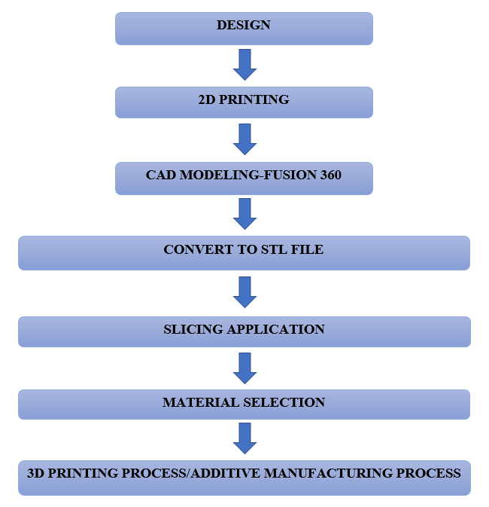
METHODOLOGY

Slide 10
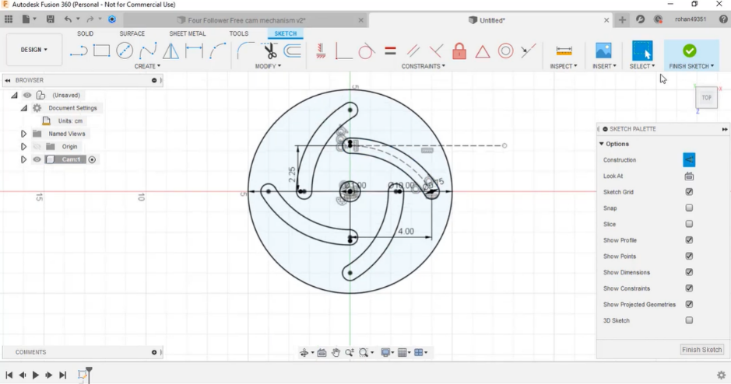
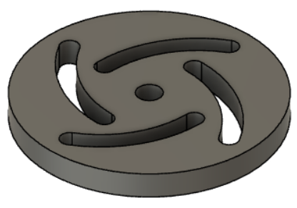
Modelling – Part 1

Slide 11
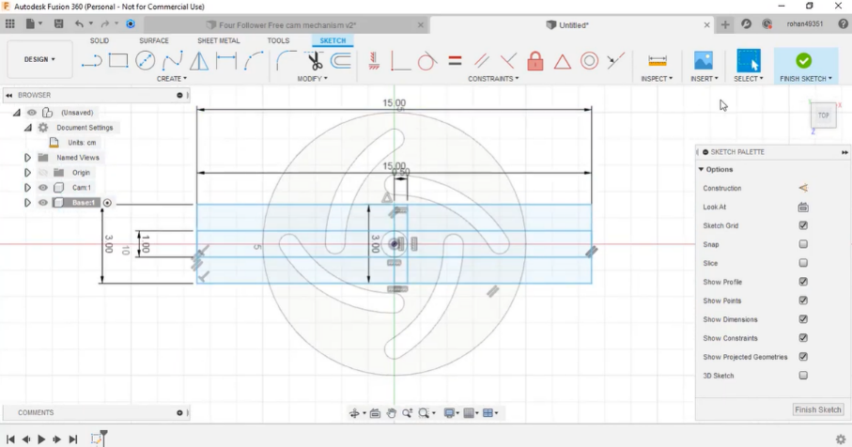
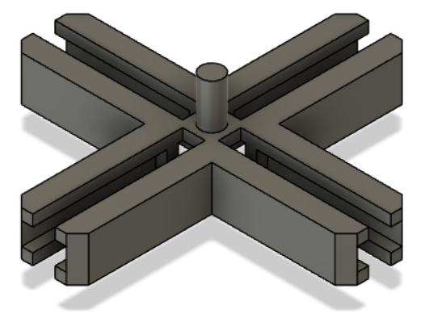
Modelling – Part 2

Slide 12
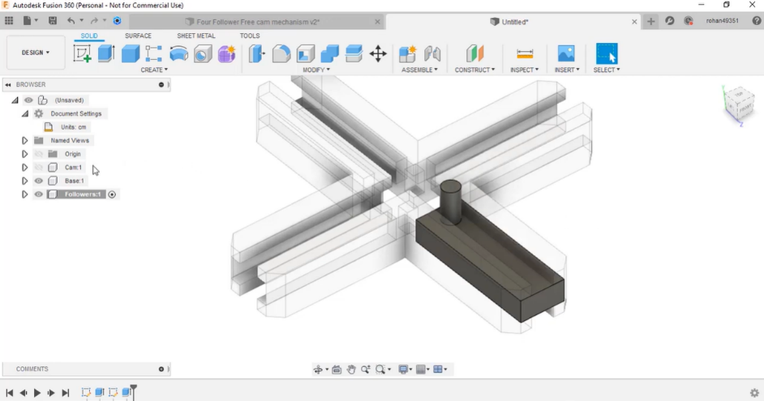
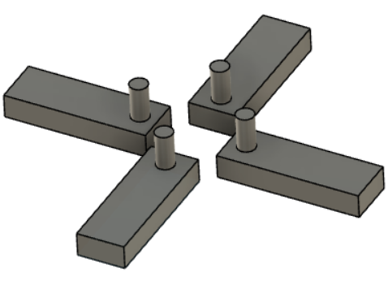
Modelling – Part 3

Slide 13
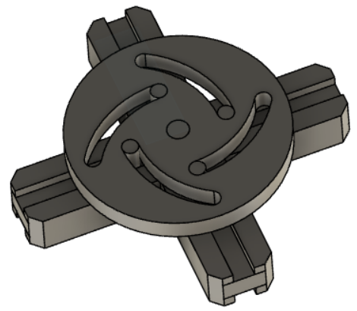
Assemble View

Slide 14
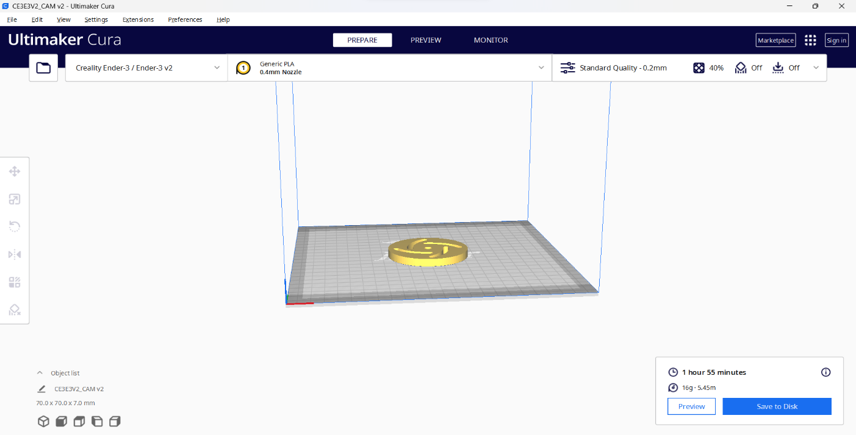
Slicing Detail-Part 1
Time taken : 1 Hour 55 minutes
Weight of the product : 16 g
Material Required : 5.45 m

Slide 15
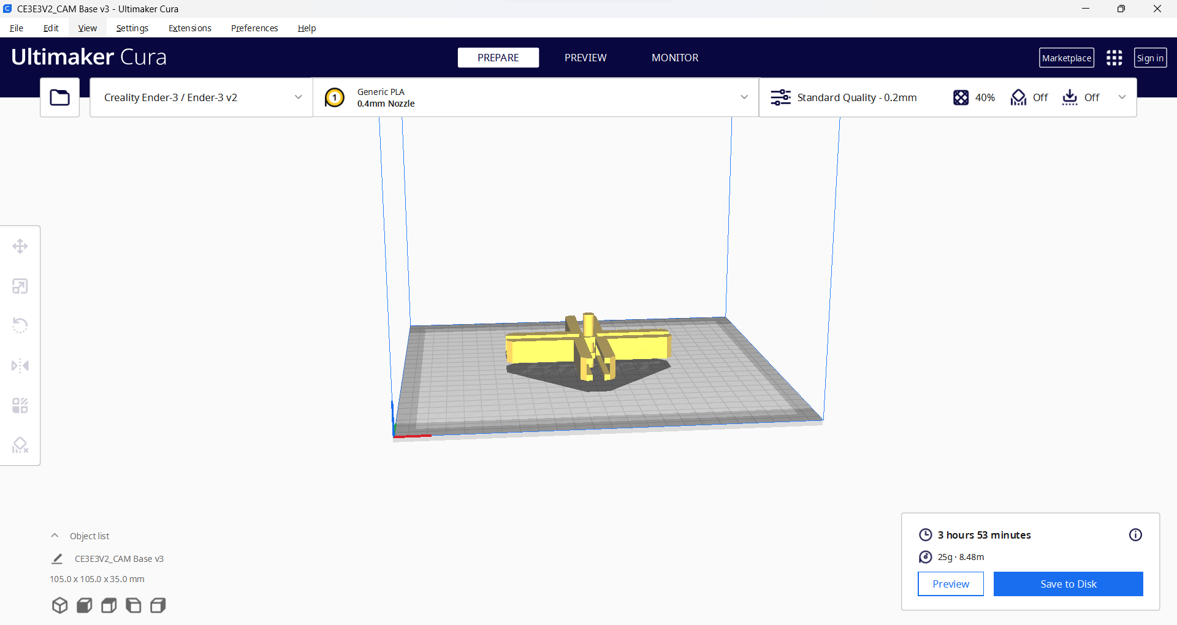
Slicing Detail-Part 2
Time taken : 3 Hour 53 minutes
Weight of the product : 25 g
Material Required : 8.48 m

Slide 16

Slicing Detail-Part 3
Time taken : 1 Hour 42 minutes
Weight of the product : 13 g
Material Required : 4.42 m

Slide 17
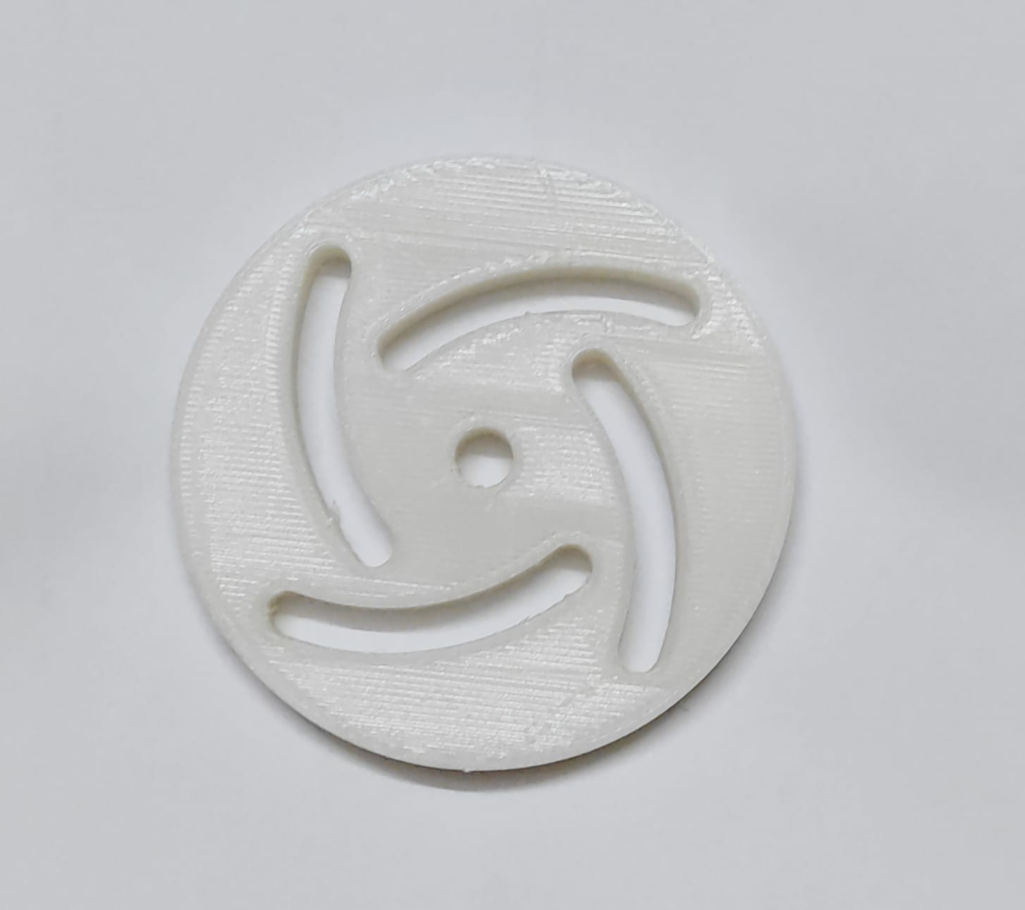
3D Print – Part 1

Slide 18
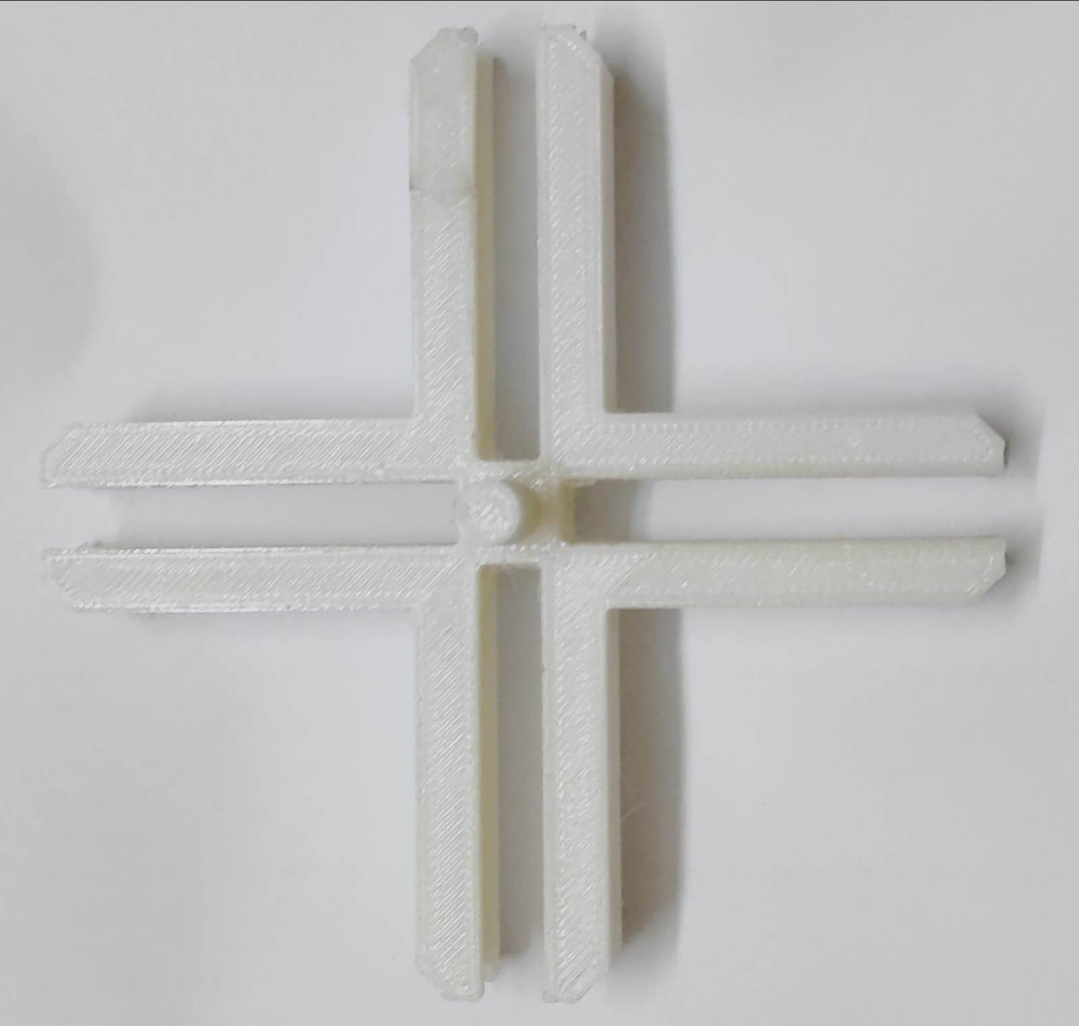
3D Print – Part 2

Slide 19
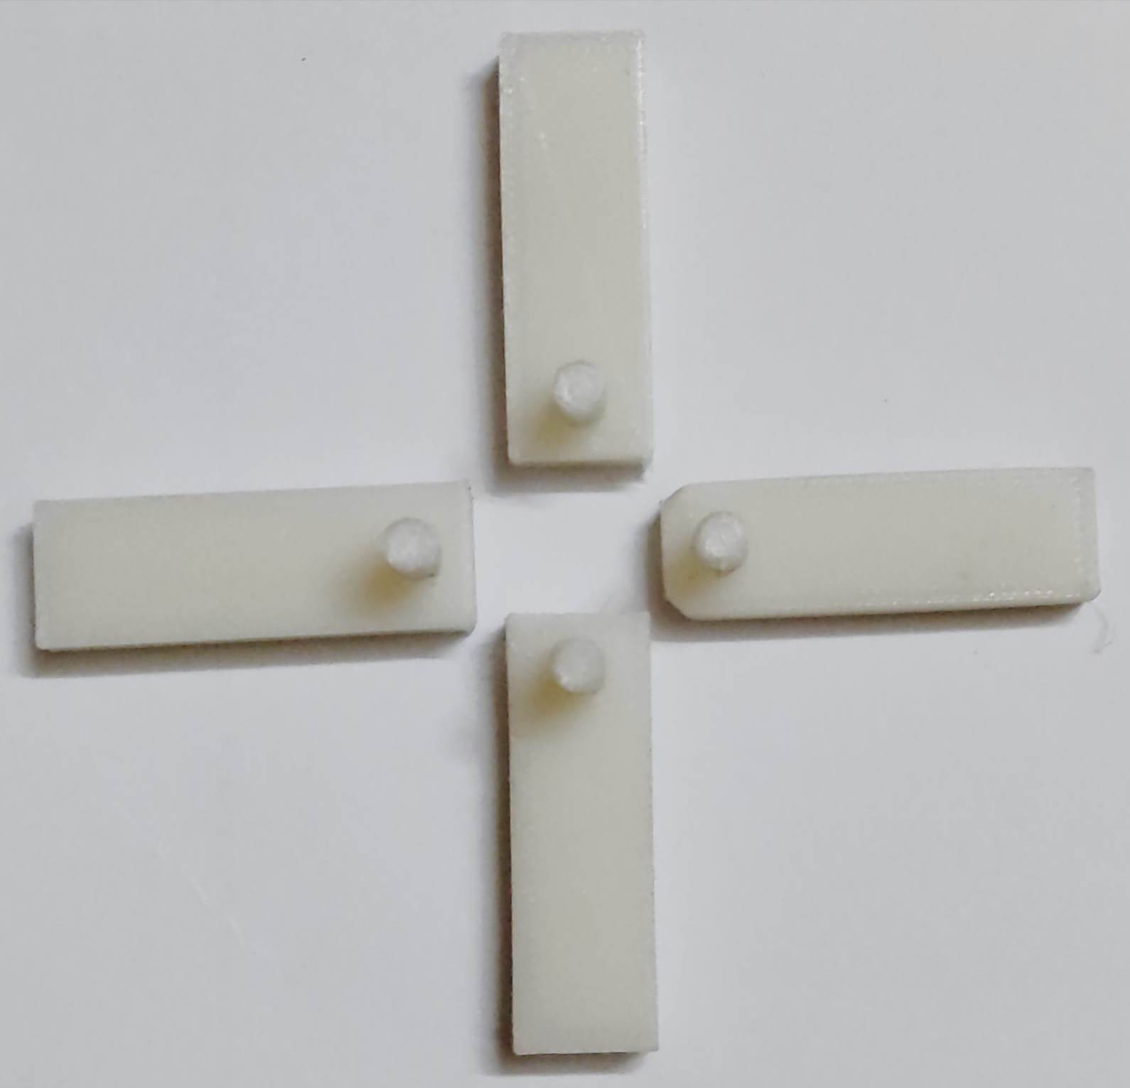
3D Print – Part 3

Slide 20
Result
The 3D printed parts are assembled as per the format and the mechanism is understood via practical approach.
Thus the model to demonstrate the slot cam and four slider mechanism is fabricated and the mechanism is understood.

Slide 21
CONCLUSION
In this project, the demonstration of the Slot cam mechanism is done with the help of 3D printed parts.
The following conclusion are drawn from the study ;
The rotary motion of the shaft along the axis is studied and understood via the assembly of the 3D printed parts.
The linear motion of the followers along the base is understood via the assembly of the 3D printed parts
The inbuilt axis is stable ensuring the stable and relative rotary and linear motion.

Slide 22
REFERENCES
Analysis of a Cam follower Mechanism for a passive parallel lower limb Exoskeleton by DV Lim, DTK Tien and ECY Chung.
A review paper "Modelling, Design and Analysis of Cam and Follower" By N. S Patel
Design and analysis of high speed Cam mechanism using Fourier series by Siyu chen
Study of the jumping phenomenon in a Cam and follower mechanism by Ali hasan.
Article on Cam transmission mechanism by Zhen Yang.

